Slide 1
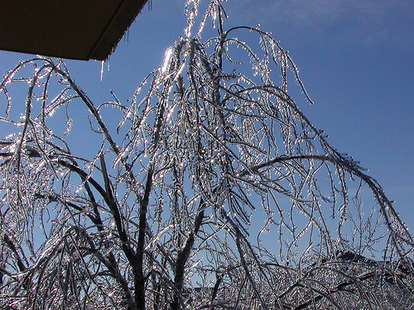
Winter Weather Safety
National Weather Service
Grand Rapids, MI

Slide 2
Outline
Winter Weather Safety – What’s the big deal?
Threats from hazardous winter weather
Planning and preparation for winter storms
Winter weather survival
After the storm – What should I do?

Slide 3
Winter Weather Safety
What the big deal?
Snowfall
  Can occur 8 months out of the year (Starting October and lasting through May)
Weak winter storms
  Still hazardous
Major winter storms
  Can
    Last days
    Be accompanied by high winds, freezing rain or sleet, heavy snow, and bitterly cold temperatures
Aftermath can leave an impact on the community or region for days, weeks or months

Slide 4
The Threat: Heavy Snow
Heavy snow can paralyze a city
Transportation can be halted
  Commuters stranded, roads impassable, and airports closed
Snow accumulations may cause
  Collapsed roofs
  Downed trees and power lines
Homes and farms could be unreachable for days
Substantial economic impacts

Slide 5
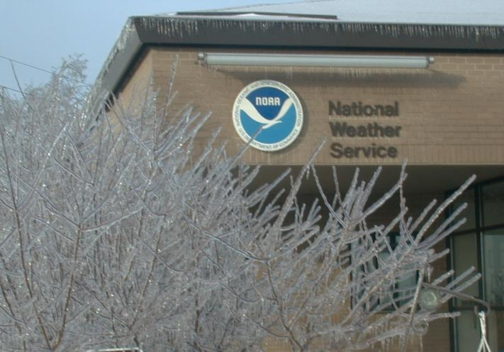
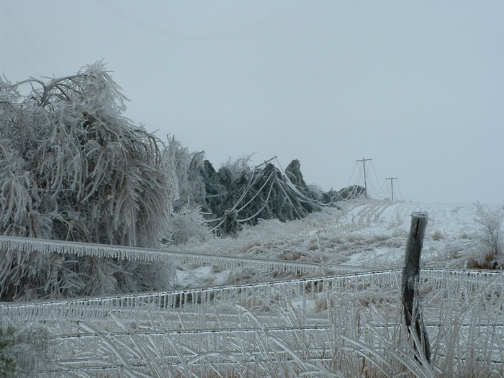
The Threat: Ice
Dangerous to drivers
Bridges and overpasses are very treacherous in icy conditions
Heavy icing can topple utility poles and communications and bring down trees
Top - Detroit Ice Storm
April 4, 2003
Left – Western Kansas 2008

Slide 6
Facts on Snow and Ice
Injuries due to ice and snow:
  70% result from vehicle accidents
  25% occur from people caught out in a storm
Most happen to males over 40 years old

Slide 7
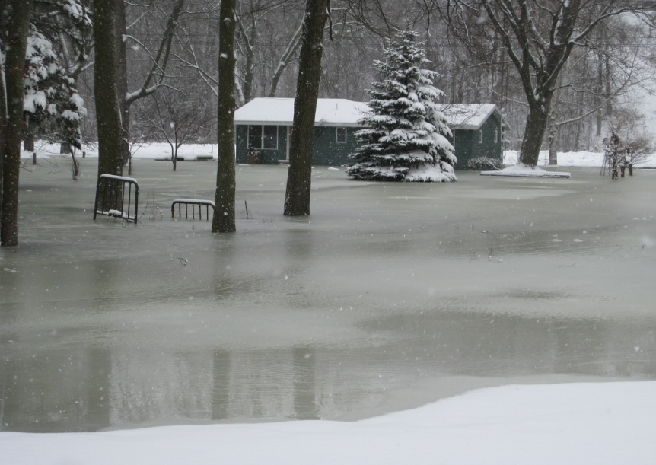
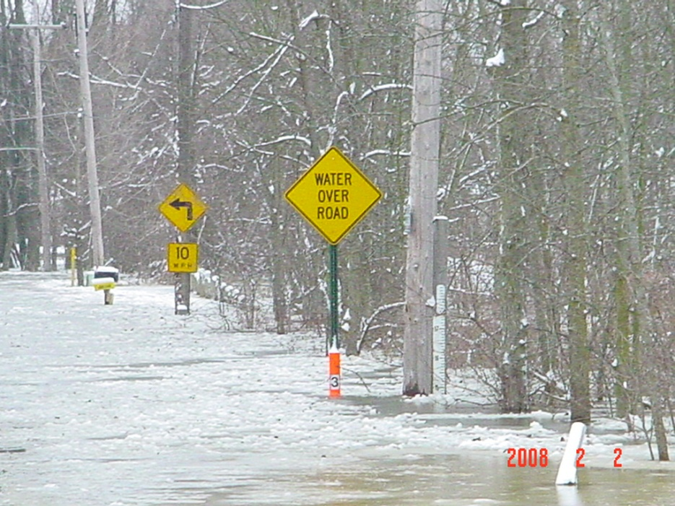
The Threats: Coastal Flooding, Ice Jams and Snow Melt
Ice Jams in Michigan

Slide 8
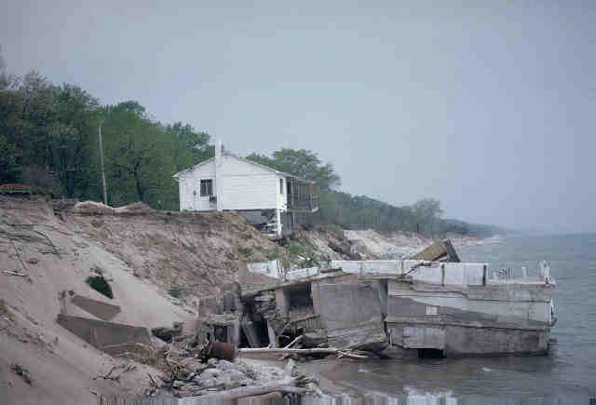
The Threats: Coastal Flooding, Ice Jams and Snow Melt
Coastal Flooding in Indiana

Slide 9
The Threat: Extreme Cold
Can lead to frostbite or hypothermia
Pipes may freeze and burst in homes that are poorly insulated or without heat
Freezing temperatures can cause severe damage to citrus fruit crops and other sensitive vegetation

Slide 10

Hypothermia
Signs
  Uncontrollable shivering
  Memory loss
  Disorientation
  Incoherence
  Slurred Speech
  Drowsiness
  Apparent Exhaustion
Seek medical attention immediately

Slide 11
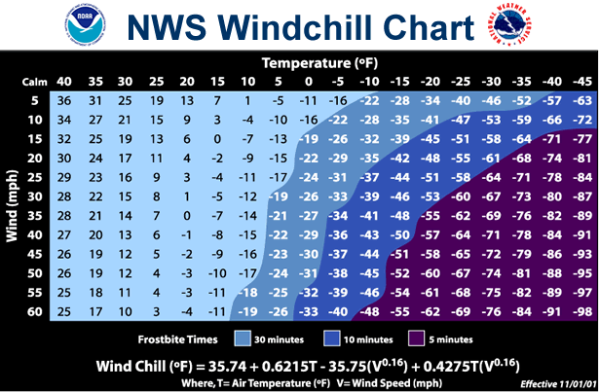
Wind Chill
What is Wind chill?
  How the cold temperatures combine with the wind feel on exposed skin

Slide 12

Injuries Related to Cold
50% happen to people over 60 years old
More than 75% happen to males
About 20% occur in the home

Slide 13
Question
What is the term for damage to body tissue caused by cold temperatures?
  Frost nip
  Hypothermia
  Frostbite
  Stone cold

Slide 14
Question
What is it called when the body temperature drops to less than 95F?
  Frost nip
  Hypothermia
  Frostbite
  Coffee time

Slide 15
What does it all mean
Preparing for the storm

Slide 16
Basic Definitions
Outlooks
Hazardous Weather Outlook (HWO)
  Issued at least one time EVERY day between 4 am and 5 am
  Outlines potential weather hazards expected over the next 7 days
  The potential for major storms beyond 2 days will be discussed in the HWO

Slide 17
Basic Definitions
WATCH
  Issued when the risk of a hazardous event has increased significantly, but its occurrence, location, and/or timing is still uncertain
  At least 50% or greater probability of event occurring

Slide 18
Winter Storm Watch
24 to 48 hours
Monitor NOAA Weather Radio and local forecasts
Plan trips around winter storms
Plan alternate routes
Be alert for changing weather conditions
Ensure adequate food and water supplies

Slide 19
Basic Definitions
Continued
WARNING
  Issued when a hazardous weather event is occurring, is imminent, or has a very high probability of occurring. A warning is used for conditions posing a threat to life or property
  At least 80% or greater probability of event occurring

Slide 20
Winter Storm Warning
12 to 24 hours
Stay indoors!
Wear appropriate clothing
Avoid traveling
Continue to monitor NOAA Weather Radio and local forecasts

Slide 21
Preparing for the Storm
At Home
Flashlight
NOAA Weather Radio
Blankets and heavy clothing
Items for infants, elderly or disabled family member
Watch for potential fire and carbon monoxide hazards

Slide 22
Preparing for the Storm
Your vehicle
First aid kit
Blankets
Flash Light/Flares
Road maps
Extra Clothing
Shovel
Non-perishable food
Cell phone
Remember to keep your gas tank full/nearly full when traveling in severe winter weather

Slide 23
Winter Safety
Outside
Avoid overexertion
Walk carefully on snowy, ice sidewalks
Wear loose-fitting, lightweight warm clothing in layers and waterproof outer layers
Keep cloths dry
Understand the hazards of wind chill

Slide 24
During the Storm
Home
To save heat, close off unneeded rooms
Maintain adequate food and water intake

Slide 25

During the Storm
If travel is necessary
Inform someone of your destination and travel time
Have a cell phone

Slide 26

During the storm
If stranded in your vehicle
Attach a bright cloth to your antenna to attract attention
Remain with your vehicle
Run the motor about 10 minutes each hour for heat
MAKE SURE YOUR EXHAUST PIPE ISN’T BLOCKED
Get attention by turning on the dome light and emergency flashers with the engine is running
Exercise

Slide 27

During the Storm
If stranded outside
Try to stay dry and cover all exposed parts of the body
Prepare a windbreak or snow cave for protection
Build a fire to attract attention
DO NOT EAT SNOW

Slide 28
Following the Storm
Continue listening to NOAA Weather Radio and media for updates and instructions
Help neighbors who may need assistance
Avoid traveling until conditions have imporved
Avoid overexertion such as shoveling snow
Be prepared when venturing outdoors for the first time after the storm

Slide 29

Summary
Stay alert for changing weather conditions
Monitor forecasts
Be prepared and plan ahead
  It could save your life!
Thanks and have a safe winter season!

